Slide 1
4.1.3. e – Control of Gene Expression
TEXT –
9.2 CONTROL OF GENE EXPRESSION

Slide 2
Learning intention Success criteria
e. Identify that there are factors that regulate the phenotypic expression of genes:
during transcription and translation (proteins that bind to specific DNA sequences)
through the products of other genes
via environmental exposure (consider the twin methodology in epigenetic studies)
e. Recognise that there are factors that regulate the phenotypic expression of genes:
during transcription and translation (proteins that bind to specific DNA sequences)
through the products of other genes
via environmental exposure (consider the twin methodology in epigenetic studies)

Slide 3
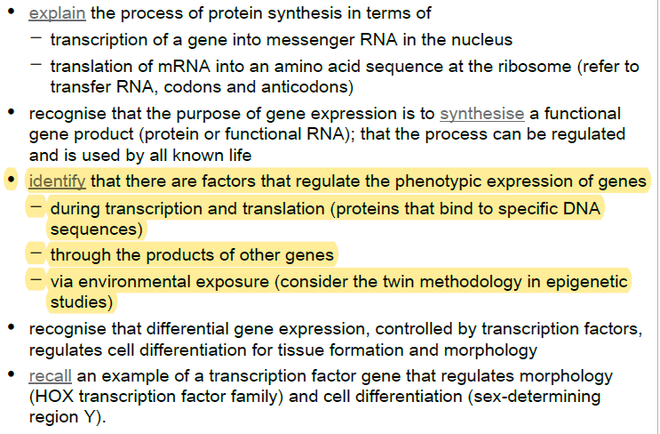
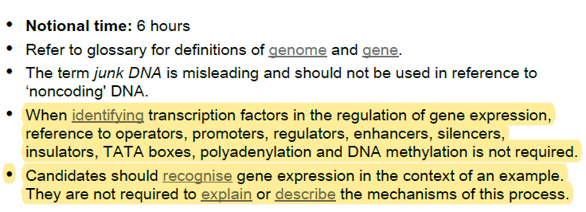
Syllabus check:
By the end of the lesson you should be able to…
NOTE SPECIFICALLY….

Slide 4
Gene regulation

Slide 5
Gene regulation
All the cells in your body (with some exceptions) carry a copy of your entire genome, but not all cells express (in their phenotype) all the possible genes present in your genome. Instead, cells differentially express genes depending on their needs.
The phenotypic expression of some genes and not others results in cell differentiation.
For example, the active genes of muscle cells only transcribe the polypeptides that are essential for muscle cell operation.
Genes that are important in nerve cells are ‘switched off’ in a muscle cell.
If all the genes were continuously activated (expressed), the muscle cell would use a lot of energy and resources to produce unnecessary proteins.
Regulation of gene expression is therefore important in cell differentiation.

Slide 6
Gene regulation
The process of expression of different genes at different rates and at different times is referred to as gene regulation. It includes a wide range of mechanisms that are used by cells to increase or decrease the production of specific gen products (protein or RNA).
Genes can be regulated at different stages: pre-transcription, post-transcription and translation.

Slide 7
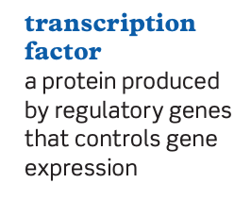
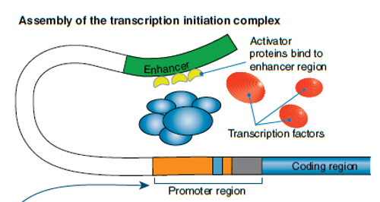


Pre-transcriptional control
Transcription occurs only during interphase when the chromosomes exist as chromatin threads. This is initiated when the DNA coding for a specific polypeptide ‘unzips’ to expose the nucleotide bases and its starting point to which the RNA polymerase attaches.
Regulatory genes associated with the structural gene, or the products of other non-coding sequences, can produce proteins (or functional RNA) that act as transcription factors. These factors (molecules) can bind to specific sequences at the start of a structural gene to either:
block the attachment of RNA polymerase, and so block the expression of that gene
alter (accelerate or decrease) the rate at which the gene is expressed.
Initiate transcription.

Slide 8
Pre-transcriptional control
In some situations, gene expression is altered by the environment influencing the regulatory gene.
The presence of a large amount of glucose, for example, would result in an increased expression of the gene coding for insulin, and block the gene for glucagon.
In contrast, minimal amounts of glucose would block insulin production and enhance glucagon production in pancreas cells.

Slide 9
Gene regulation – more on this next lesson
Negative gene Regulation:
Signaling molecule interact with repressor proteins that dictate whether genes will be expressed.
Positive gene regulation:
Signaling molecules generate a complex that interacts with DNA (common in eukaryotes).

Slide 10
Post-transcriptional control
Once the mRNA has been produced, cells are capable of controlling the amount of protein produced. This is achieved by modifying the post-transcriptional process, or longevity of the mRNA.
Non-coding DNA can alter the rate or block the trimming, capping and tailing of the mRNA. For example, if the non-coding introns are not removed correctly, the resulting mRNA may be broken down by enzymes. Some small non-coding RNAs may bind to the mRNA to form a double- stranded RNA, which then cannot be translated. Once the mRNA is completed it must pass through the nuclear pores to the cytoplasm. This is an active process that requires the recognition of the transcript by receptors lining the interior of the nuclear pores. This allows further control, and gene expression can be achieved by alteration of pore receptors.

Slide 11
Translational control
Ultimately, any particular mRNA will be enzymatically degraded. Gene expression can be regulated by controlling the length of time the mRNA survives before it is degraded.
Many different proteins and amino acids are involved in the translation process. By controlling the amounts of these molecules, the rate of gene expression can accelerate or decrease. An example is microRNA.
A microRNA (abbreviated miRNA) is a small single-stranded non-coding RNA molecule (containing about 22 nucleotides) found in plants, animals and some viruses, that functions in RNA silencing and post-transcriptional regulation of gene expression.
Even after a polypeptide chain has been formed, chemical modification is required before the final protein is produced. Again, the availability of additional chemical groups, or enzymes, will therefore affect the complete expression of the gene.

Slide 12
Epigenetics

Slide 13
Epigenetic control of gene expression
The epigenome (‘above the genome’) is a set of factors that affect which part of the DNA is activated.
These factors may occur as a result of intra-cellular or extra-cellular stimuli, by neighbouring cells, by physiology, or entirely by the environment to which the organism is exposed.
Each cell type in an individual’s body has its own epigenome.
Muscle cells (that only express the genes they need) can only replicate to form muscle cells.
Throughout the individual’s life the DNA in all cells remains constant (excluding chance mutations), but the epigenetic factors in each cell may change.
The epigenome acts by producing chemical tags or factors (methyl or acetyl groups) that do not change the DNA ‘blueprint’, but determine which genes are switched on (expressed) and which are switched off (repressed). These factors bind to specific sequences in the DNA.

Slide 14
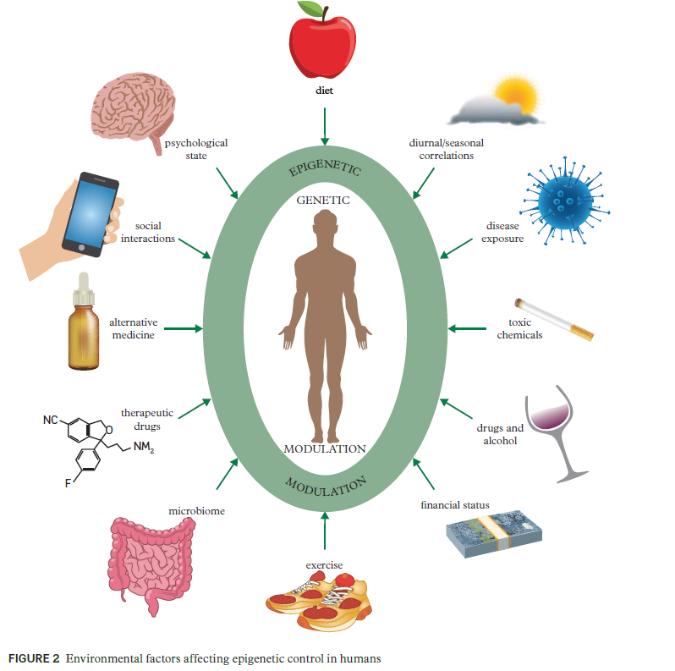
Epigenetic control of gene expression
The activation of these factors can be influenced by a range of variables or interactions.

Slide 15
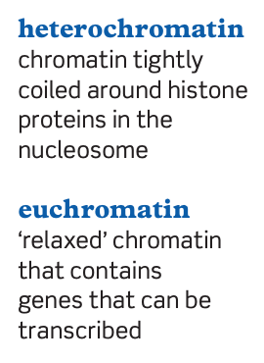
Histone modification
Each DNA molecule in the non-dividing cell nucleus is found as fine threads of chromatin that at intervals are wrapped around four pairs of histone protein molecules to form nucleosomes.
There are two different forms of chromatin: • heterochromatin
• euchromatin.

Slide 16
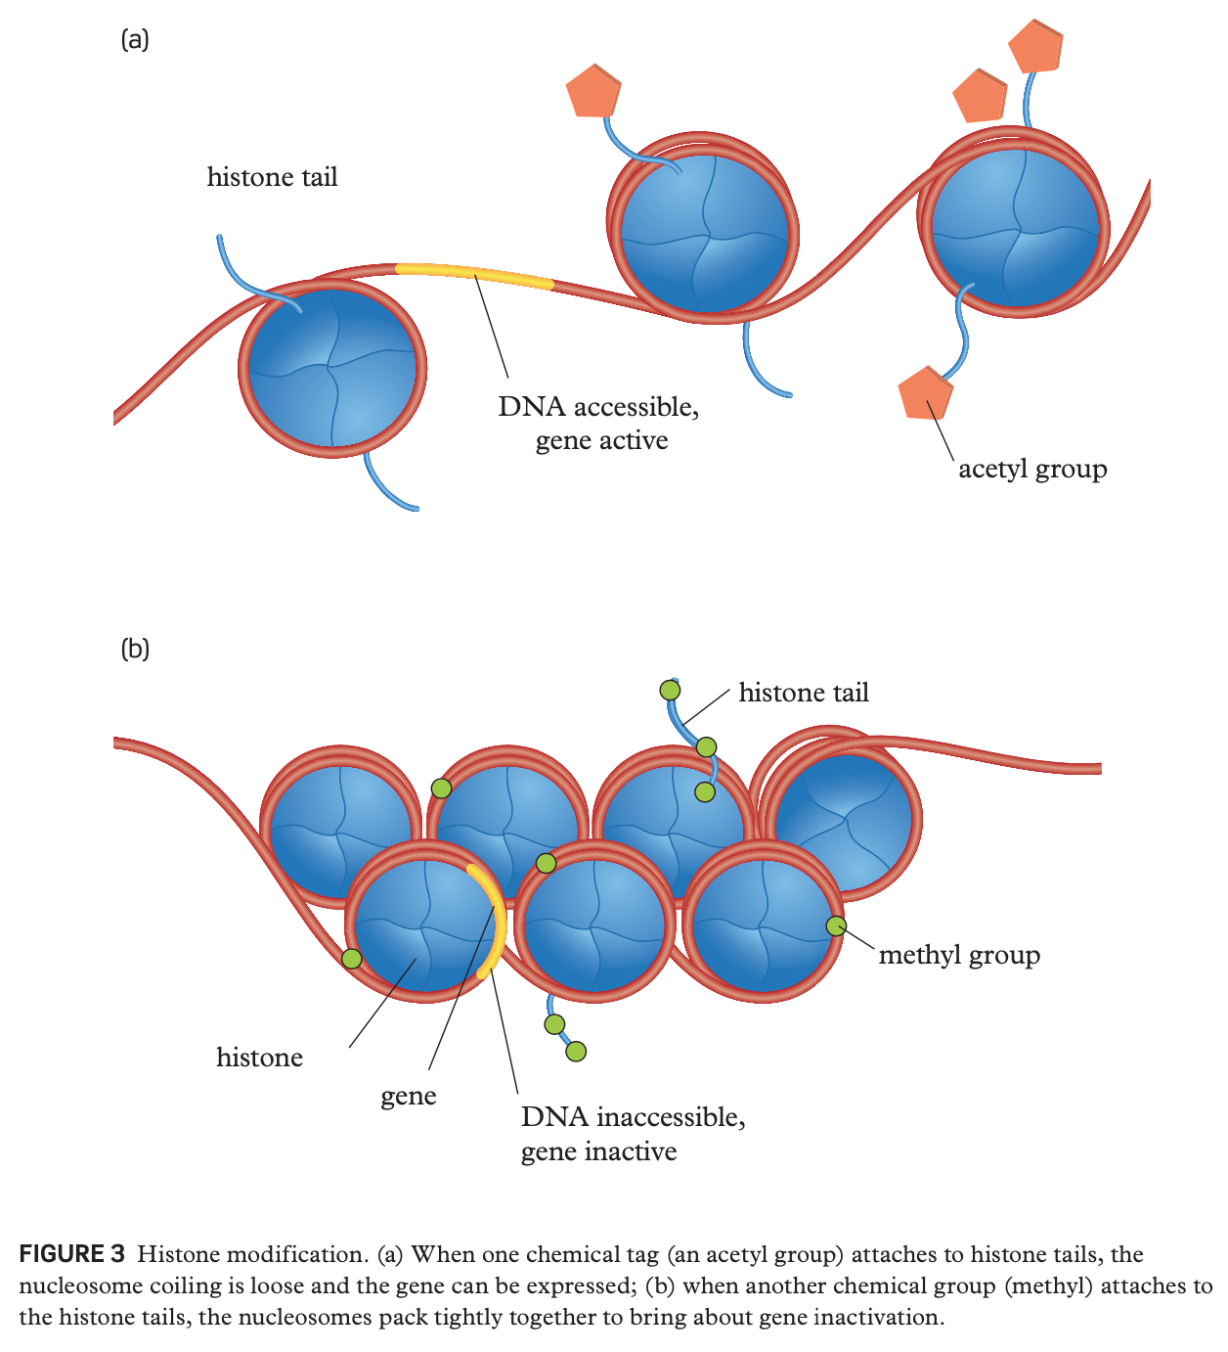
Histone modification
The nucleosomes can be spaced tightly together or far apart. The spacing is controlled by the presence or absence of chemical tags attached to the tails of the histone proteins that either pull the nucleosomes closer together or allow the structure to be more open.
When an acetyl group tag attaches to specific amino acids on the tails of the histone molecules in a nucleosome, the histone structure relaxes, and the nucleosomes move further apart. This section of the DNA is more easily accessed by transcription – the gene is switched on.
Methyl group tags on other sites of the tails of histone molecules of the nucleosome make the coiling of the chromatin tighter and the nucleosomes closer together. The DNA between the nucleosomes cannot be accessed and any genes contained in those sections cannot be read. The genes are switched off in those pieces of DNA.

Slide 17
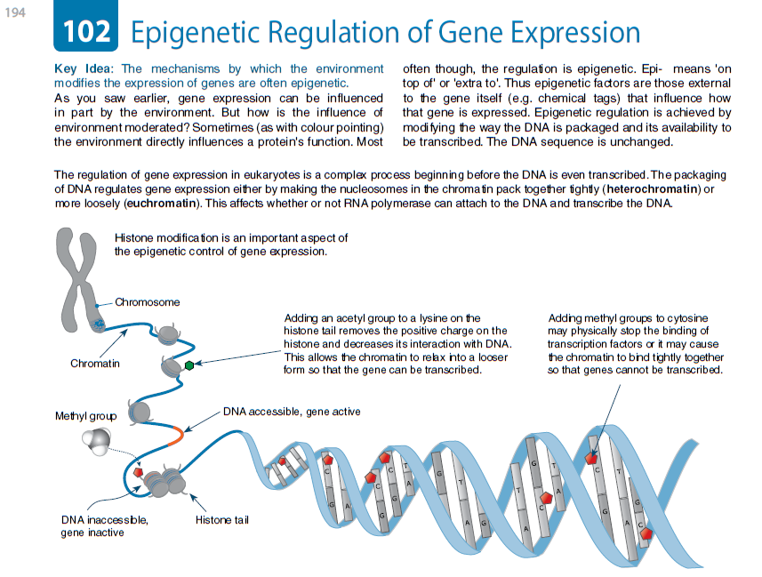

Slide 18
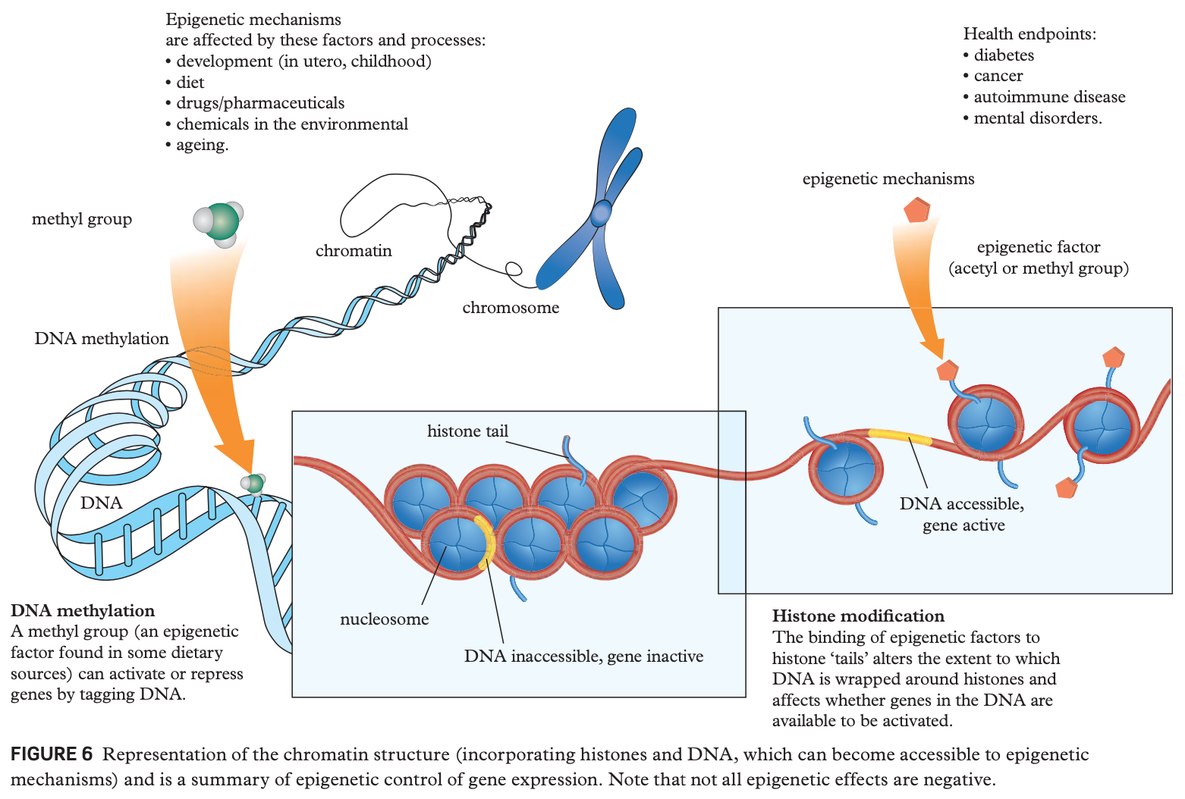

Slide 19
Exit ticket: e. Identify that there are factors that regulate the phenotypic expression of genes: - during transcription and translation (proteins that bind to specific DNA sequences) - through the products of other genes - via environmental exposure (consider the twin methodology in epigenetic studies)
PA MOCKEXAM 2020 MC
QUESTION 16
Haemoglobin gene expression is restricted to erythroid cells. This process is controlled by
mutation.
translation factors.
haemoglobin genes.
transcription factors.

